Slide 1
INTRODUCTION
Introduction Domain - AIML
Team Number - Team 1
Team Members - Jhansi M (SM24NS00048)
Pallavi Asareddy (SM24NS00070)
Rashmi Rani C K (SM24NS00072)
B Nikitha (SM24NS00090)
Project Title – STYLE TRANSFER

Slide 2
About the project
1.What is the project all about?
Style Transfer is a deep learning technique that applies the artistic style of one image to another image while preserving its original content. This is achieved using Convolutional Neural Networks (CNNs), particularly through techniques like Neural Style Transfer (NST), which uses a pre-trained model (e.g., VGG19) to separate and recombine style and content features from images.

Slide 3
2.Why have you chosen the problem statement?
The problem of Style Transfer is chosen because:
It has applications in art and design, allowing users to create artistic transformations of images.
It demonstrates the power of deep learning in computer vision.
It can be used in entertainment, advertising, and digital media to generate unique content.
It enhances user creativity by giving them tools to convert ordinary images into artistic masterpieces inspired by famous paintings or textures.
3. Features of the project
Style Transformation – Apply different artistic styles (e.g., Van Gogh, Picasso) to an image.
Content Preservation – Maintains the original structure of the input image while modifying the style.
Multiple Style Blending – Ability to mix multiple styles into a single image.
Custom Style Upload – Users can upload their own style images for transfer.
Real-Time Processing – Faster style transfer using models like MobileNet or Fast Style Transfer.
User Interface – A web or mobile app for users to upload images and select styles.

Slide 4
Technology Stack
Software Requirements
Operating System: Windows 10/11
Programming Language: Python (3.10 to 3.13)
Deep Learning Framework: TensorFlow / PyTorch
Libraries: OpenCV, NumPy, Matplotlib, PIL (Pillow)
Development Tools: Jupyter Notebook / VS Code / PyCharm
Hardware Requirements
Processor: Intel i5/i7/i9
RAM: Minimum 8GB
Storage: Minimum 50GB

Slide 5
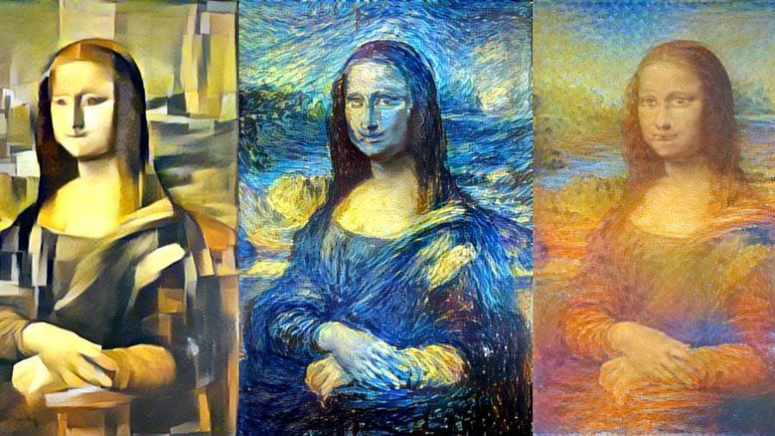
Screenshots

Slide 6
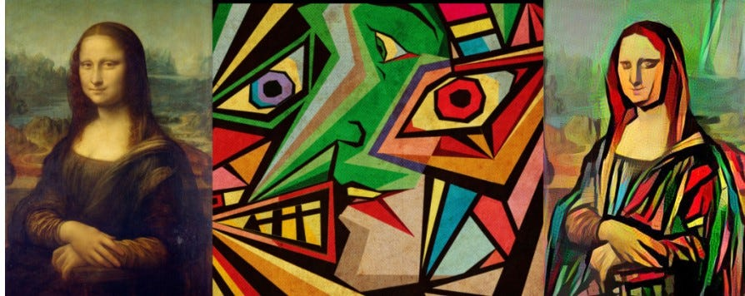

Slide 7
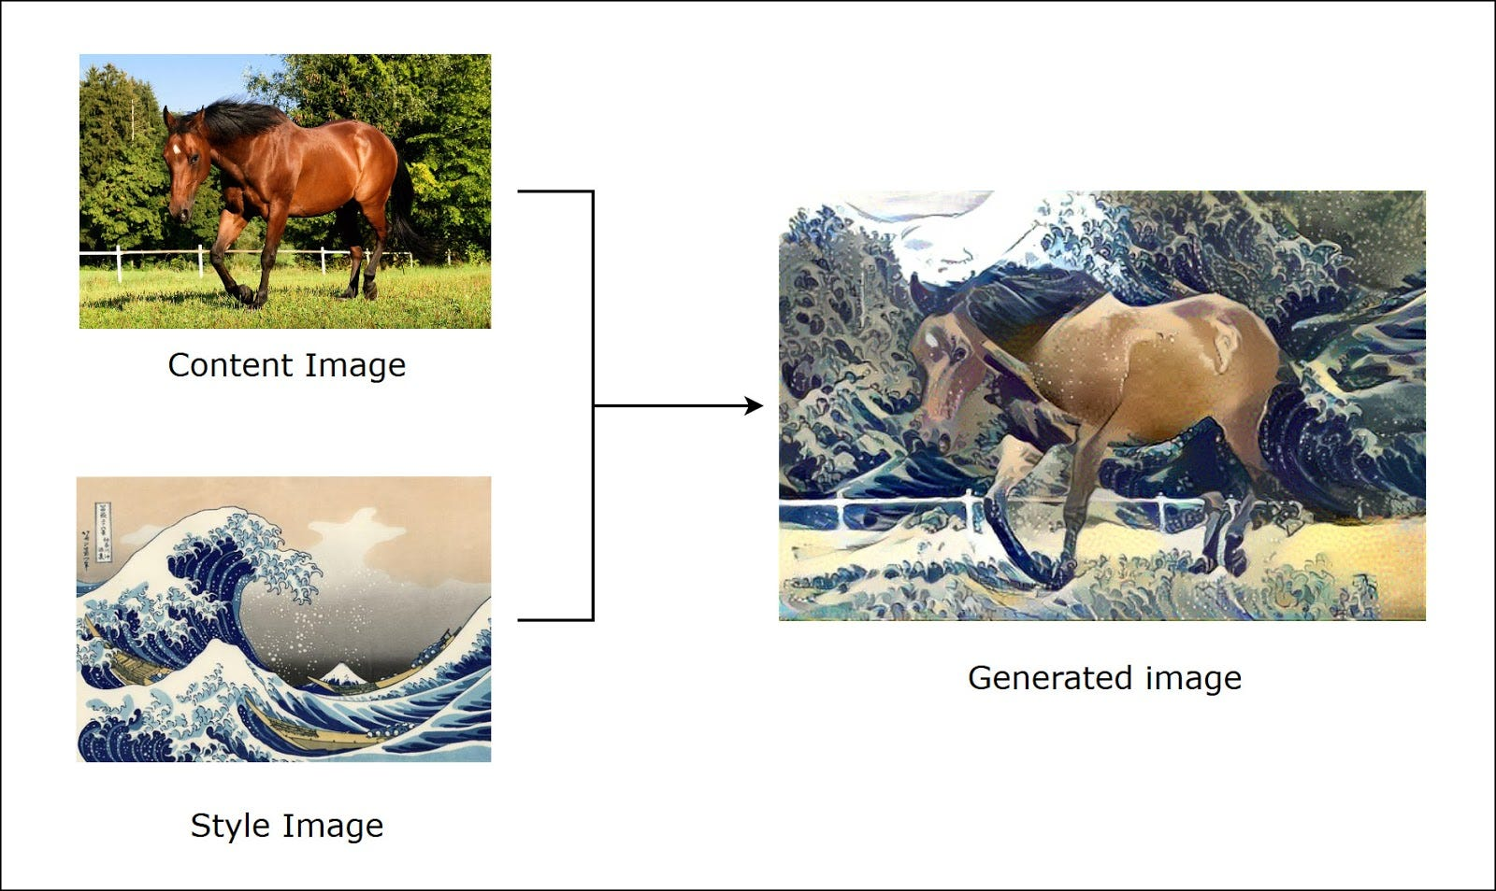
This is the Image with clear reference that how our projects works.!!

